Slide 1
Biomedical signal process
Homework 1 : ecg data process result

Slide 2
oUTLINE
INTRODUCTIONS
METHODS
RESULTS
DISCUSSION

Slide 3
introduction- 1.1
Use cross-correlation function as threshold
Use moving average filter
Discuss threshold high and low

Slide 4

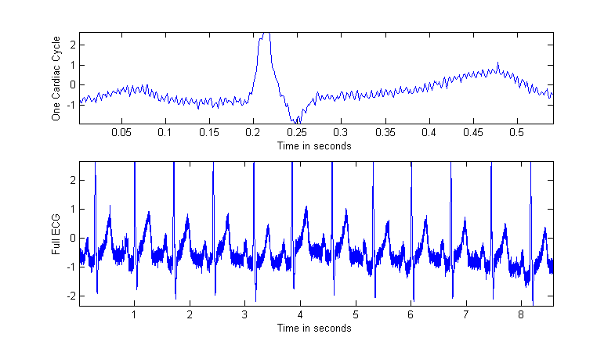


Method
Identify a full cardiac cycle :
It seem like 12 cycle in the ECG figure ,so I choose fist one full cycle to use .
Mathematical method :
$tail=head+\frac{ECG.Length − 80}{12}$
The data point are ECG(80:707 ,1).

Slide 5
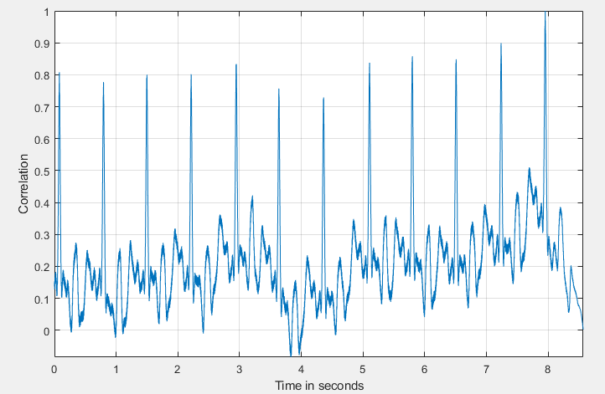
Method
Create correlation graph
The graph is created by using Matlab command xcorr(), and this function will output phase shift and correlation.
The graph of previous slide was created using phase shift and correlation make x-y plot.

Slide 6
Method
Set threshold for processing
The graph shows the correlation above 0.6 can be adapted as threshold.

Slide 7
Method
Down size by 4
Create a separate data set ecg4() by load one data in every 4 data .
Down size by 8
Create a separate data set ecg8() by load one data in every 8 data .

Slide 8
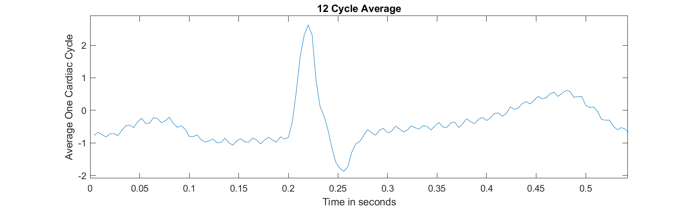
rESULT
Down Size by 4 and 6 cycle average

Slide 9
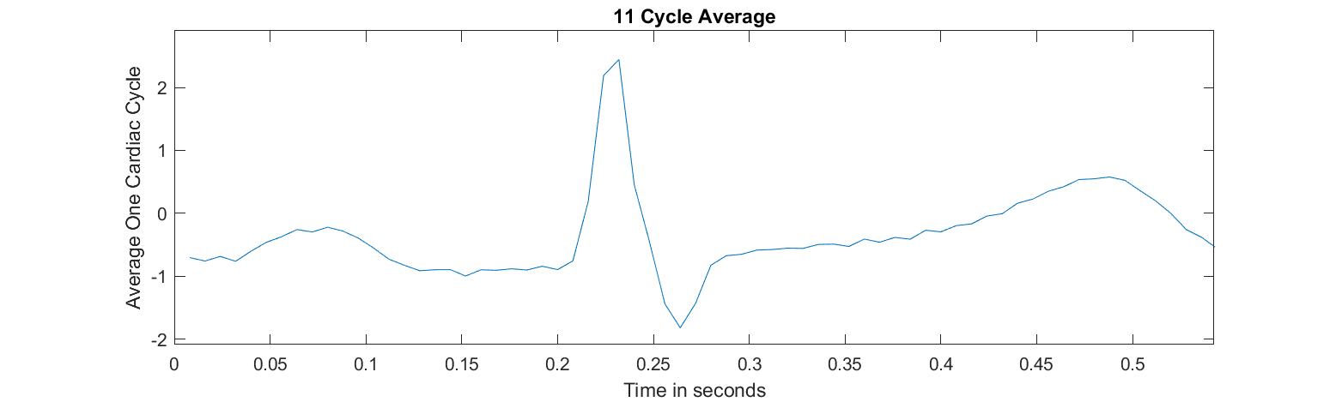
result
Down Size by 8 and 3 cycle average

Slide 10

result
Threshold | False Positive | True Positive (#)
0.6 | 0 | 12
0.55 | 0 | 12
0.5 | 0 | 12
0.45 | 5 | 12
0.4 | 15 | 12
0.35 | 26 | 12
0.3 | 56 | 12
0.25 | 83 | 12
0 | 8567 | 12
Threshold Change
Correlation values 0.6 cleanly identify all peak.

Slide 11

discussion
About Choose a full cardiac cycle :
Although I choose fist one as my full cardiac cycle , and use the function :
$$tail=head+\frac{ECG.Length −head}{12}$$
but it is not a good mathematical function to identify because of its head just rely on visual inspection.

Slide 12
discussion
Threshold Choose:
By finding the local max of the peak method , it is a common and useful method .
When the threshold is too lower , the false positives will increase and be identified.
If those false positive location be used in filter , the shape of the wave I guess it will change ,so it could be the result incorrectly.

Slide 13
discussion
About Down Size
Down Size the sample ECG make the shape of the wave smooth , sharp , and cleanly.
For capture certain frequency of sound the sapling rate must certain frequency of sound the sampling rate must be greater and equal than Double of sound frequency .
Down sampling cause that the shape of the cardiac cycle be shaper , and let some information of the cardiac cycle is lost. Maybe high filter frequency noise is a good method for couting ECG cycle down sampling.

